Slide 1
Handwritten Digit Recognition

Slide 2
Introduction
How can you make a computer recognise single handwritten digits?
MNIST handwritten digit database:

Slide 3
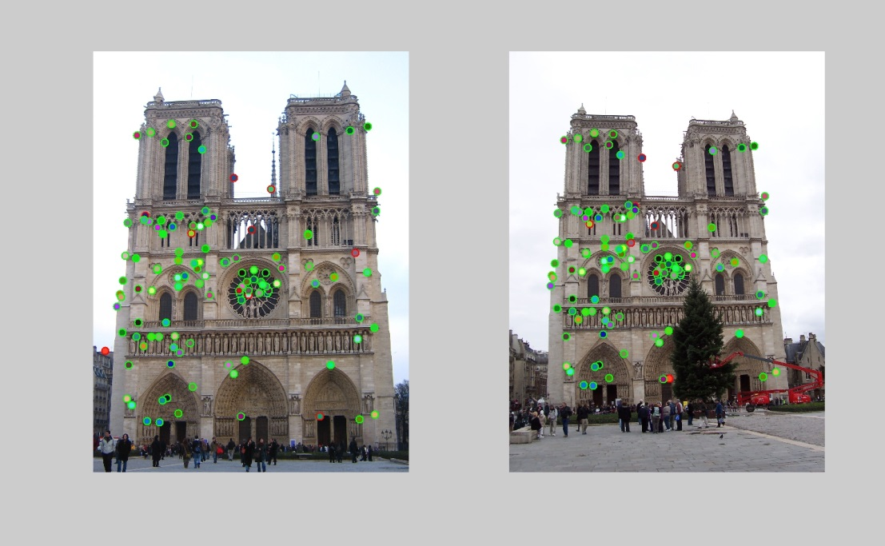
Introduction
Use knowledge of digit „layout“
  Circles, corners, SIFT-Features
    Scale-invarian feature transform

Slide 4
Introduction
Still, everyone writes a „9“ a little bit different
  It‘s hard to implement those differences in an algorithm with „extert knowledge“
Conclusion:
Use a learning algorithm

Slide 5
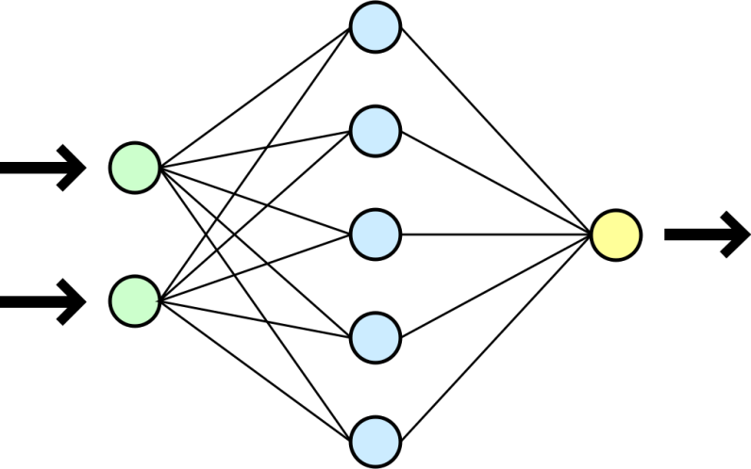
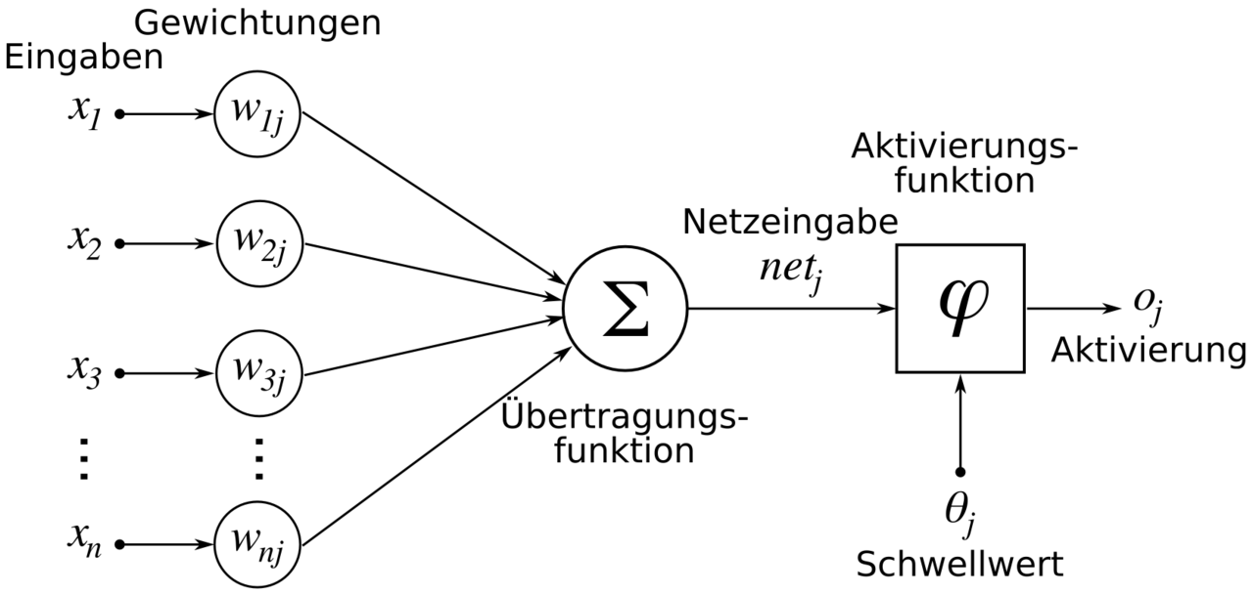
Methods
Learning Algorithm: Neural Network

Slide 6
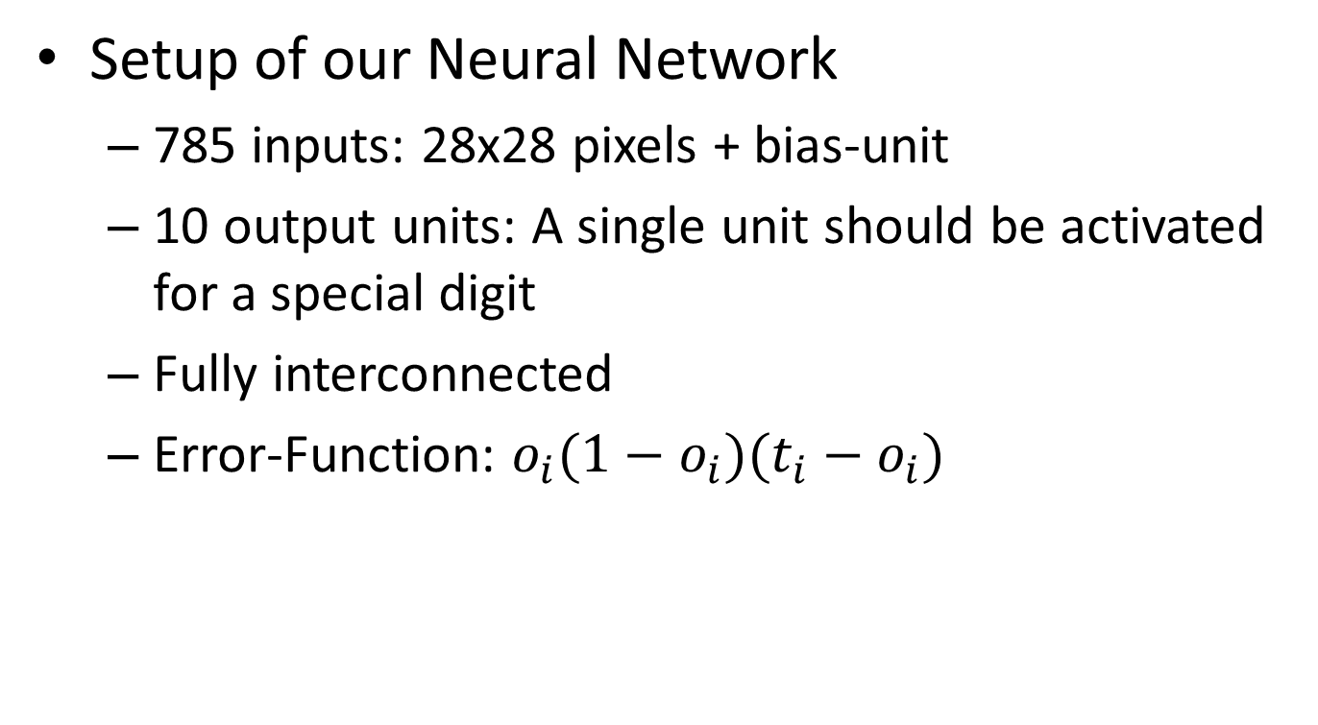
Methods
Setup of our Neural Network
  785 inputs: 28x28 pixels + bias-unit
  10 output units: A single unit should be activated for a special digit
  Fully interconnected
  Error-Function: $o_{i}(1−o_{i})(t_{i}−o_{i})$

Slide 7
Methods
Database: MNIST database
  70.000 images of digits10.000 pictures used for this, 1000 for each digit
  85% used for training, 10% for testing, 5% for veification
  With labels

Slide 8
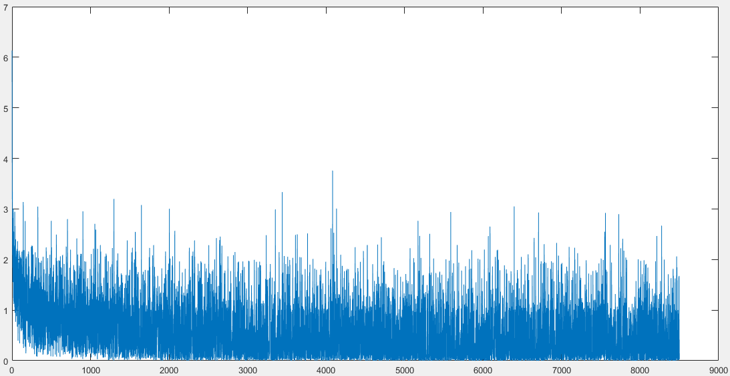
Results so far
Small demo

Slide 9
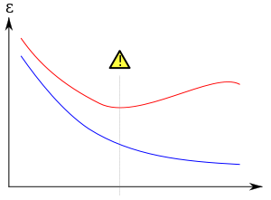
To be implemented
Using testing data
  Show overfitting
  Cancel learning
  process
Taking picture of a student writing a digit, scale and process it to be put into learning algorithm

